Slide 1

INTRODUCTION TO C#
FOR POWERSHELL DEVS
PRATEEK SINGH
DEEPAK SINGH DHAMI
@singhprateik
@dexterposh

Slide 2
Agenda
Why should we learn C#?
Overview of C# language
Compilers, Runtime and .NET Framework
C# Hello World
Interactive C# - Bridging the gap between scripting & development
Running C# program in PowerShell and vice-versa

Slide 3
Prerequisites
Install .NET Core SDK
Visual Studio Code and the C# extension from the VS Code Marketplace.
Visual Studio (Optional) that comes with additional benefits
C# Interactive (csi.exe) - The C# REPL Command-Line Interface
Working with C# in VSCode - https://code.visualstudio.com/docs/languages/csharp

Slide 4
Why should I learn C# ?
Let's admit that if you are in IT today, you are a developer! (Sort of*)
Uses .NET classes
Wide range of applications and use cases:
Cross platform applications
Websites
Games
Cloud services
Machine learning and AI
C# has an active online community!
Amazing tooling to support development – Visual Studio, VS Code
Azure + PowerShell + C# = 👌😎

Slide 5
Overview of C# Language
C# is a powerful, flexible and very popular modern programing language, which is simple & easy to learn and at the same time elegant as a programming language of few words.
Modern
Open source and Cross platform
Object Oriented
Type safety
Modular
Secure
Robust, Versatile and Evolving

Slide 6
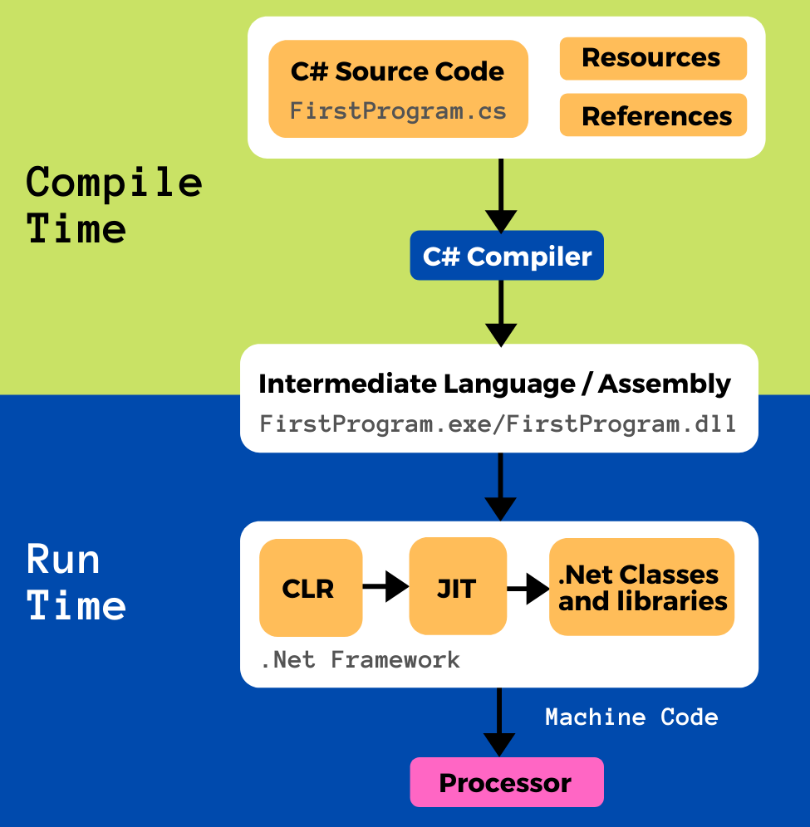
Compilers, Run Time & .Net framework
COMPILER TIME: Transformation of source code to Intermediate Language (IL)
RUN TIME: Conversion of Intermediate language into machine code & executing machine code instructions.

Slide 7
C# Hello World!
DEmo

Slide 8
Interactive C#
Bridge between Scripting to Development
Reduces the barrier to entry by providing interactive sessions
Following ways
C# Interactive window in Visual Studio
Dotnet-script extension for .NET Core
Jupyter notebooks
Notes:
- Interactive programming environments to explore and play with command and expressions

Slide 9
C# to PWSH - RoundTrip
Use C# inside your PowerShell scripts (Add-Type)
Convert C# code into PowerShell for quick prototyping
Make your scripts more robust by leveraging underlying .NET Types

Slide 10
References
C# hello world explained - https://ridicurious.com/2020/07/07/powershell-to-csharp-and-back-hello-world-explained/
[Blog Series] PowerShell to C# and back!
https://dexterposh.github.io/tags/pwshtocsharpandback/
https://ridicurious.com/powershell-to-csharp-and-back/
[Book] PowerShell to C# and Back! - https://leanpub.com/powershell-to-csharp
Download the FREE E-book Sample that covers C# primer - 40-page introduction of the C# language and its constructs from Hello world program, to variable, data types, conditional statements, loops, class and objects, error handling.

